Slide 1

DF Coaching
A web application for coaching and scorecard process automation

Slide 2
Table of Contents
Overview
Scope & Limitation
Components
Login
Admin Control Panel
Dashboards
Sessions
Printing
History
Feedback form

Slide 3
Overview
This web application mainly focused on automating the existing process of coaching in the Digital Fulfillment department, making it a paperless process. The web application can also help leaders to organize their team and also help agents to monitor their status based on the available data.

Slide 4
Scope
Limitations
Accurately display scorecard item and its actual score depending on the agent’s role
Add/modify existing scorecard item details for every roles
Display team data of leaders
Display the current score standing of agents
Manage the sessions per week
Highly dependent on Excel file when displaying score data
Excel file must be reformat as (*.xlsx) file and convert all formulas to values
Excel file containing score data must be updated daily to reflect the data displayed for the users
Cannot dynamically add another type of session (Scorecard, Coaching, Triad, etc..)

Slide 5

Components Login

Slide 6
Components Admin Control Panel Add/Update Credential

Slide 7
Components Admin Control Panel Delete Credential

Slide 8
Components Admin Control Panel Upload Data

Slide 9
Components Admin Control Panel Upload Manual Data

Slide 10
Components Admin Control Panel Update Scorecard Items

Slide 11
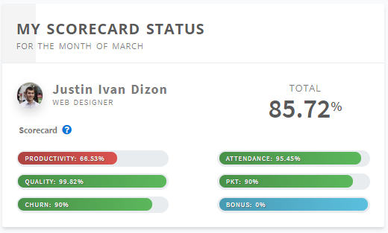
Components Dashboard My Scorecard Status
Displays the current scorecard summary of the agent based on the actual data
(Available only for agents)

Slide 12
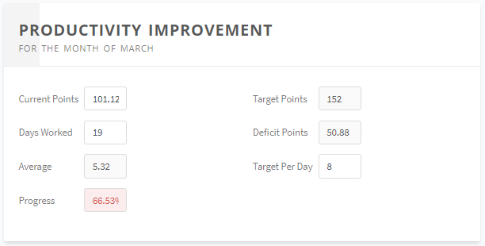
Components Dashboard Productivity Improvement
Lets you simulate your productivity score
Agents can adjust the fields Current Points, Days Worked and Target Per Day
(Available only for agents)

Slide 13
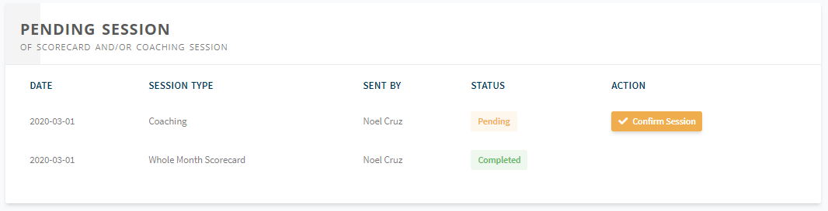
Components Dashboard Pending Session
Lets the user access their pending sessions and view their details and current status
(Available to all roles with different component titles)
Titles
Agent: Pending Session
Supervisor: My Summary
OM & OH: Supervisors Summary

